Slide 1

AI-Based Intelligent Cloud Resource Management and Auto Scaling System Using Model-Based Reinforcement Learning
MLA0301 - Reinforcement Learning
Presented by:
Supervised by:
D.Haritha (192425254)
G.Yaswitha(192325087)
R.Rupasree(192472122)
Madhulika(192472188)
Dr.G A Senthil

Slide 2


ABSTRACT
Nowadays, cloud applications are widely used, and the workload can increase or decrease at any time.
When the workload increases, more CPU, memory, and servers are needed. When it decreases, unnecessary resources should be removed.
This project uses Artificial Intelligence and Model-Based Reinforcement Learning to automatically manage cloud resources.
The system monitors CPU usage, memory usage, number of users, and workload to understand the current situation.
The AI predicts future workload and automatically decides whether to increase, decrease, or maintain the resources.
The main goal is to reduce cloud cost, prevent server overload, improve performance, and use resources efficiently without continuous human control.

Slide 3

INTRODUCTION
Nowadays, many applications and services are hosted on the cloud because cloud computing provides flexible and scalable resources.
The number of users and workload can change continuously, which can cause servers to become overloaded or resources to be unnecessarily unused.
Auto Scaling helps by automatically increasing or decreasing cloud resources according to the workload.
In this project, Artificial Intelligence and Model-Based Reinforcement Learning are used to learn cloud behavior and make better resource-management decisions.
The main aim is to automatically provide the required resources, reduce unnecessary cloud costs, improve system performance, and prevent server overload.

Slide 4
LITERATURE REVIEW
Author and Title | methodology | Advantages | Disadvantages
S. Kayalvili et al. (2025) Resource Allocation Using Reinforcement Learning | Used prediction and Reinforcement Learning for cloud resource allocation. | Reduces cost and improves resource usage. | Training is complex.
J. Pan et al. (2025) Task and Resource Allocation Using Deep Reinforcement Learning | Used Deep Reinforcement Learning for task scheduling and resource scaling. | Improves cloud performance and resource allocation. | Requires more computing power.
J. Santos et al. (2026) Reinforcement Learning for Cloud Auto-Scaling | Used Reinforcement Learning to automatically scale cloud resources. | Handles changing workloads automatically. | Results depend on training data.
Adaptive Container Auto-Scaling for Fluctuating Workloads (2025) | Combined workload prediction with Reinforcement Learning for auto-scaling. | Improves resource utilization and handles workload changes. | Model is more complex.

Slide 5

PROBLEM STATEMENT
Cloud workloads can increase or decrease frequently depending on the number of users and applications.
High workloads can overload servers, resulting in slow response and poor performance.
Allocating too many resources during low workloads causes unnecessary cloud costs.
Traditional auto-scaling methods may react slowly to sudden changes in workload.
Therefore, an AI-based Model-Based Reinforcement Learning system is needed to predict workload changes and automatically allocate the required resources.

Slide 6

OBJECTIVES
To monitor cloud resources such as CPU usage, memory usage, workload, and number of users.
To predict future workload changes using Model-Based Reinforcement Learning.
To automatically increase or decrease resources according to the predicted workload.
To prevent server overload and improve application performance by making timely scaling decisions.
To reduce cloud costs and improve resource utilization through intelligent resource management.

Slide 7
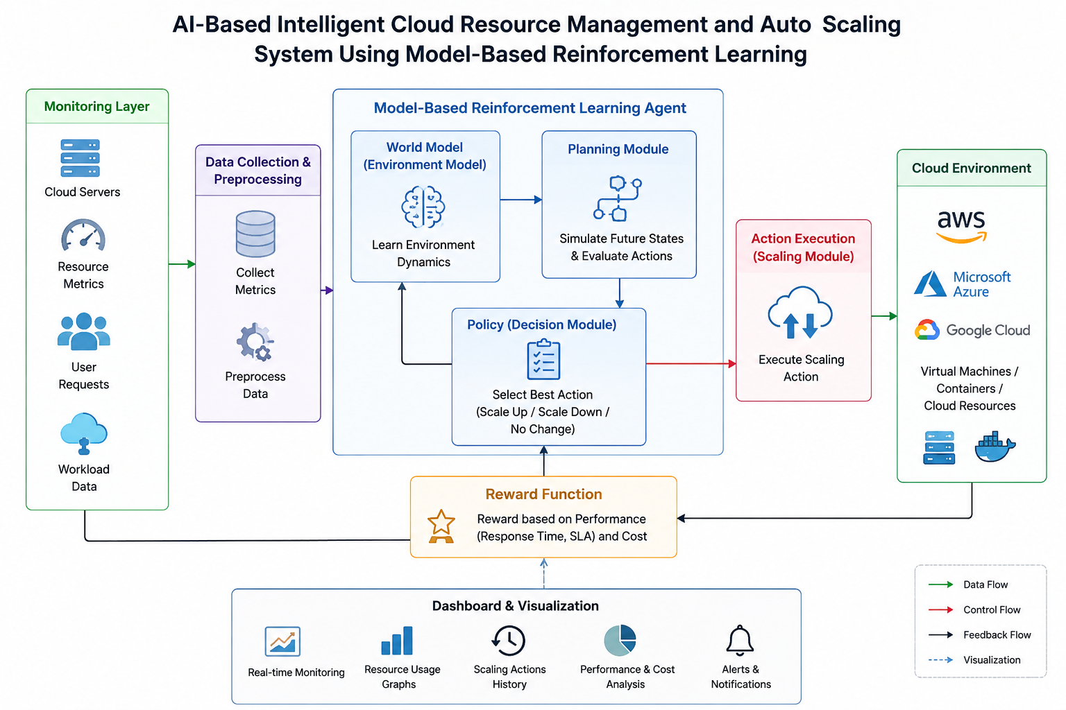
ARCHITECTURE SYSTEM

Slide 8
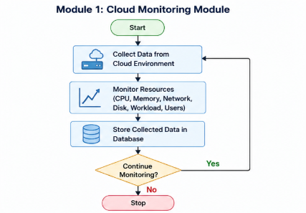
MODULE 1:CLOUD MONITORING
What it does: Monitors cloud resources continuously and collects information such as CPU usage, memory usage, workload, and user requests.
Technique Name: Real-Time Cloud Resource Monitoring
How Technique is Implemented: The system continuously collects resource usage data from the cloud environment. The collected data is sent to the AI system, which uses it to understand the current workload and resource condition.

Slide 9
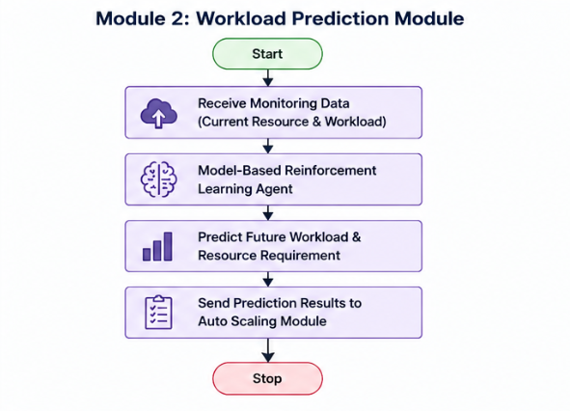
MODULE 2:WORKLOAD PREDICTION
What it does: Predicts the upcoming workload and estimates how many cloud resources will be required.
Technique Name: Model-Based Reinforcement Learning
How Technique is Implemented: The system learns how cloud resources behave under different workloads. It uses the learned model to predict future workload conditions and evaluate possible resource-management actions.

Slide 10
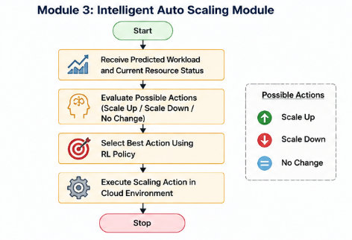
MODULE 3:INTELLIGENT AUTO SCALING
What it does: Automatically increases or decreases cloud resources according to the workload.
Technique Name: AI-Based Auto Scaling
How Technique is Implemented: The AI evaluates the current and predicted workload and selects one action: Scale Up, Scale Down, or No Change. The selected action is then applied to the cloud resources.

Slide 11
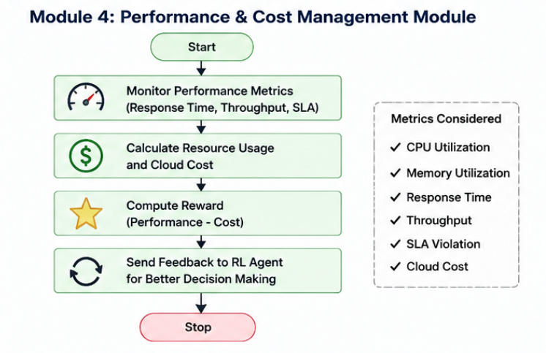
MODULE 4:PERFORMANCE AND COST MANAGEMENT
What it does: Checks system performance and cloud resource cost after scaling.
Technique Name: Reward-Based Resource Optimization
How Technique is Implemented: The system evaluates response time, resource usage, performance, and cost. These values are used as feedback to improve future scaling decisions and achieve better performance with lower cost.

Slide 12
RESULTS AND DISCUSSION
The system successfully monitors cloud resources such as CPU usage, memory usage, and workload.
The Model-Based Reinforcement Learning model can predict future workload conditions and resource requirements.
The auto-scaling module automatically selects Scale Up, Scale Down, or No Change based on the workload.
The system helps prevent server overload and maintains better application performance.
Intelligent resource allocation helps reduce unnecessary resource usage and cloud cost.
Overall, the proposed system provides efficient, automatic, and intelligent cloud resource management with less manual intervention.

Slide 13
APPLICATIONS
Cloud Data Centers – Automatically manages servers and resources based on workload.
Web Applications – Handles sudden increases in users and requests without server overload.
E-Commerce Platforms – Provides extra resources during high-traffic periods like sales and festivals.
Online Streaming Services – Adjusts resources according to the number of users watching videos.
Banking and Financial Systems – Maintains stable performance when transaction requests increase.
IoT and Real-Time Applications – Dynamically manages resources for continuously changing data and workloads.

Slide 14
FUTURE SCOPE
Advanced Workload Prediction: Improve prediction accuracy using advanced AI and deep learning techniques.
Multi-Cloud Support: Extend the system to manage resources across AWS, Microsoft Azure, and Google Cloud.
Real-Time Auto Scaling: Make scaling decisions faster for sudden changes in workload.
Cost Optimization: Further reduce cloud costs by selecting the most economical resources.
Self-Learning System: Allow the reinforcement learning model to continuously learn from new workloads and improve its decisions.
Large-Scale Deployment: Extend the system for large applications, data centers, and enterprise cloud environments.

Slide 15
CONCLUSION
The proposed system uses AI and Model-Based Reinforcement Learning to manage cloud resources intelligently.
It continuously monitors CPU, memory, workload, and user requests.
The system predicts future workload and resource requirements before making scaling decisions.
It automatically performs Scale Up, Scale Down, or No Change based on the workload.
The approach helps reduce cloud cost, prevent server overload, and improve performance.
Overall, the system provides efficient, automatic, and intelligent cloud resource management with less human intervention.

Slide 16
REFERENCES
Kayalvili, S. et al. (2025) – An Optimized Resource Allocation in Cloud Using Prediction Enabled Reinforcement Learning.
Feng, X. et al. (2025) – Adaptive Container Auto-Scaling for Fluctuating Workloads in Cloud.
Santos, J. et al. (2025) – Can Reinforcement Learning be Generalized for Efficient Auto-Scaling in Containerized Clouds.
Santos, J. et al. (2025) – Gwydion: Efficient Auto-Scaling for Complex Containerized Applications in Kubernetes Through Reinforcement Learning.
Pan, J. et al. (2025) – A Dual Scheduling Framework for Task and Resource Allocation in Clouds Using Deep Reinforcement Learning.
Zhou, G. et al. (2024) – Deep Reinforcement Learning-Based Methods for Resource Scheduling in Cloud Computing: A Review and Future Directions.

Slide 17
THANK YOU!

